Slide 1

ADVANCED programming LESSON: HOW TO USE your NXT Light sensor with your Ev3
By LEGO WORKS

Slide 2
GOAL
The goal of this lesson is to help you use your NXT Light Sensors with your EV3
The main purpose of the code is to calibrate your NXT sensors
Thank you to FLL Team Lego Works from PA for sharing this lesson with us
Please note that you will need to understand FILES to use this code. We will add a lesson on this topic soon.

Slide 3
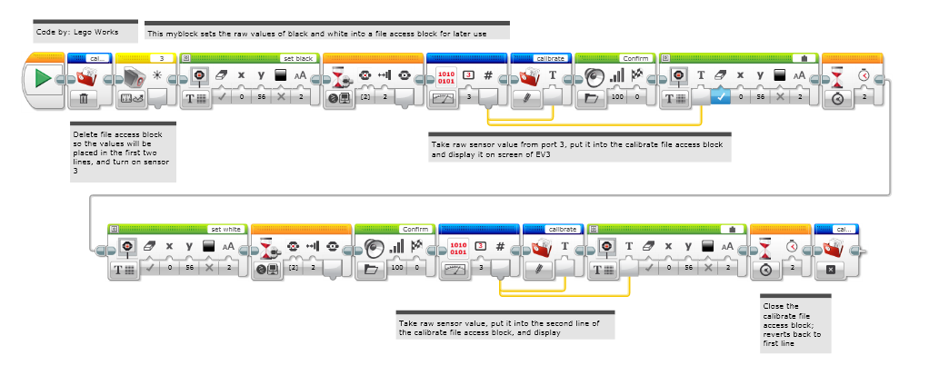
STEP 1: CALIBRATE_LS: Store Black/White Readings to FILES

Slide 4
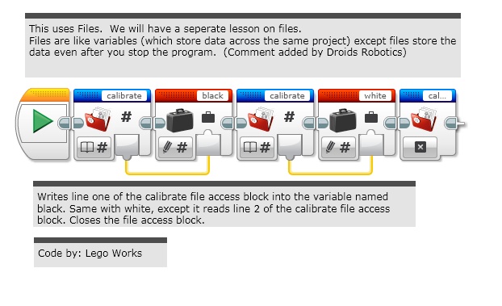
STEP 2: VARIABLE_SET: READING THE VALUES into Variables

Slide 5
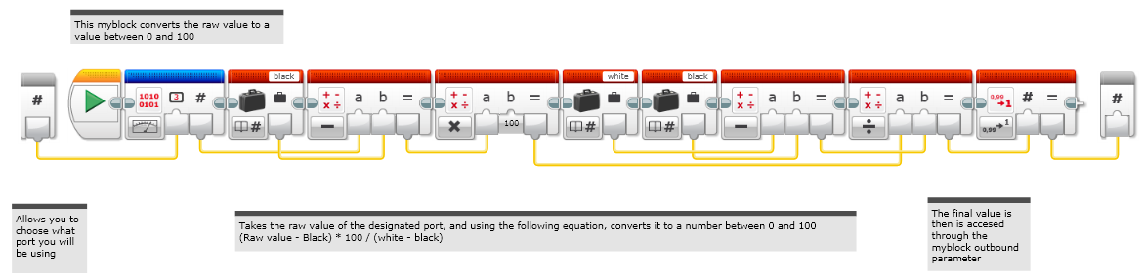
STEP 3: LIght_sensor: Normalize the Light Sensor Readings to 0-100

Slide 6
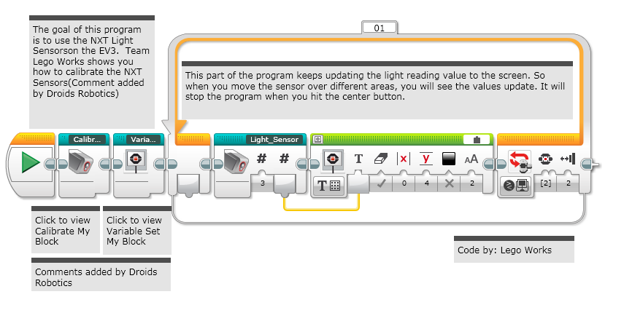
STEP 4: TEST Loop: Calibrating and Reading

Slide 7
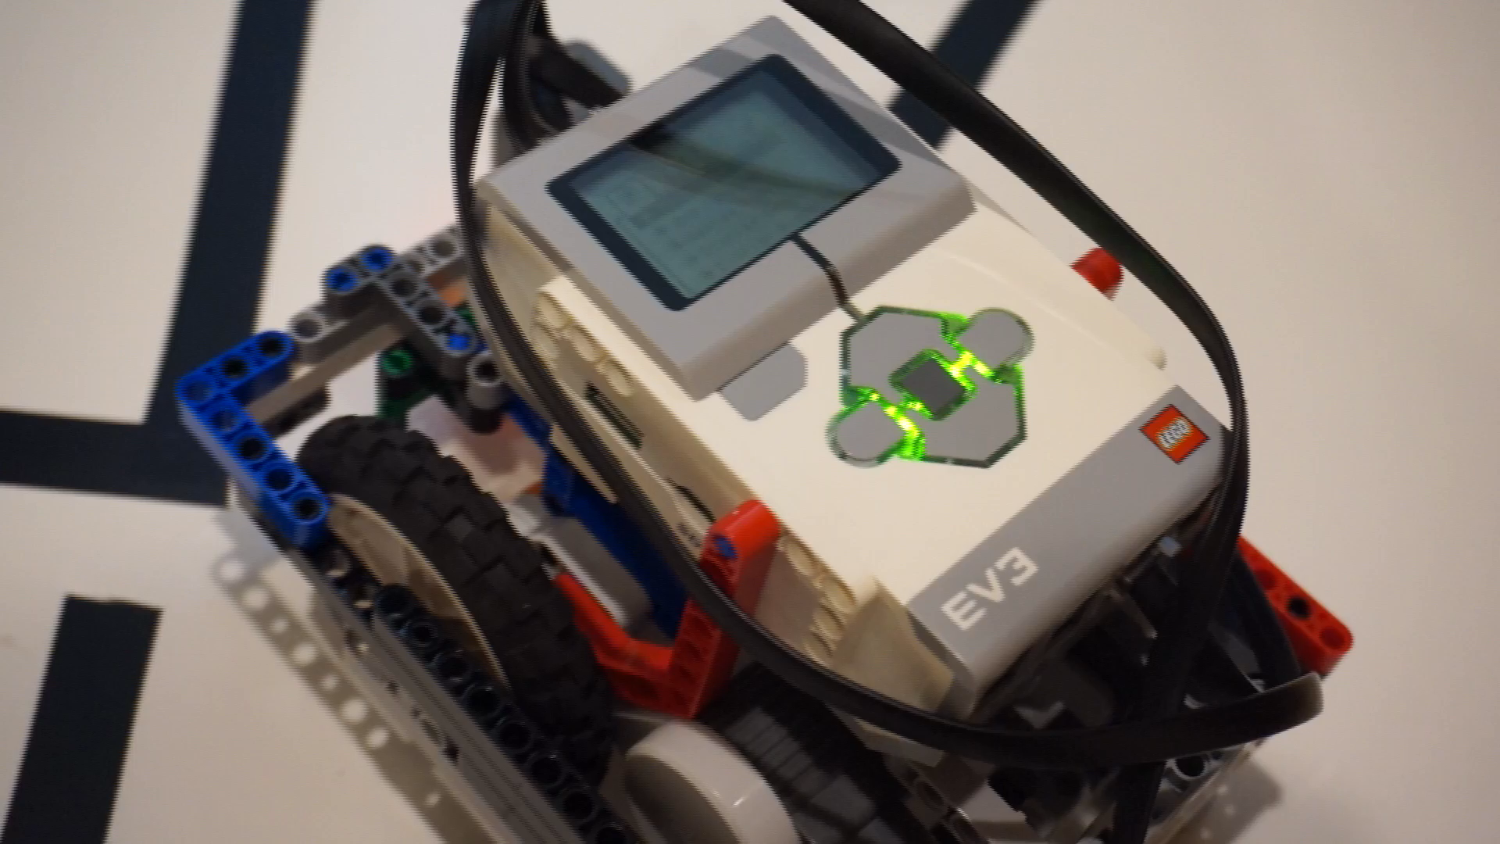
Video OF Running the PROGRAM
Watch this video to see how this code works.

Slide 8
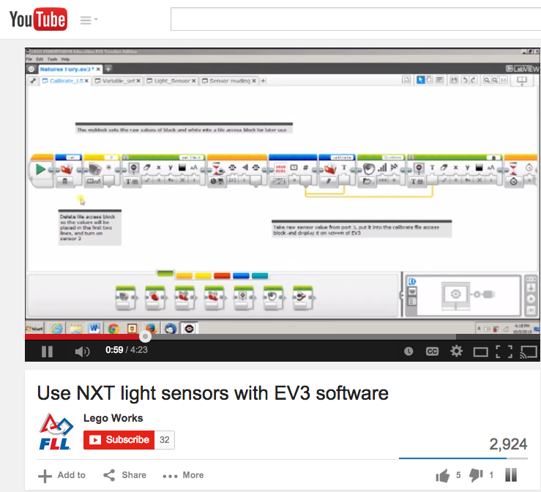
YouTube Version of the Same Tutorial
For this lesson, we have an added bonus: a YouTube companion lesson…
Visit
https://www.youtube.com/watch?v=I7Bqvk-uMLk

Slide 9

CREDITS
This lesson was compiled by FLL Team Not the Droids You Are Looking For
The lesson has been graciously shared by FLL Team Lego Works
http://www.legoworks.org/
legoworks2013@gmail.com
This material is free to use and distribute
More lessons at: www.ev3lessons.com

